Slide 1
Indoor Localization using
Ultra-wideband
Authors:
Supervisors:
Yitong Quan
Prof. Dr. Leonhard Reindl
Dr. Rüdiger Quay

Slide 2
Outline
Motivation
Scope of Work
Result
Conclusion

Slide 3

Motivation
Aim:
Accurate Indoor Localization
Task 1
Data Collect System Improvement
Task 2
System Performance Evaluation

Slide 4
Motivation
GPS
- Outdoor
Utral-Sound
+ Indoor
- Multipath(NLOS)

Slide 5
Motivation
GPS
- Outdoor
Utral-Sound
+ Indoor
- Multipath(NLOS)
UWB
+ Indoor
+ Penetrating
through((NLOS))
+ High bandwidth

Slide 6
Motivation
GPS
- Outdoor
Utral-Sound
+ Indoor
- Multipath(NLOS)
UWB
+ Indoor
+ Penetrating
through((NLOS))
+ High bandwidth
UWB
range 3.1 GHz to 10.6 GHz
limited transmit power of -41dBm/MHz
very low power density levels
for short-distance application

Slide 7
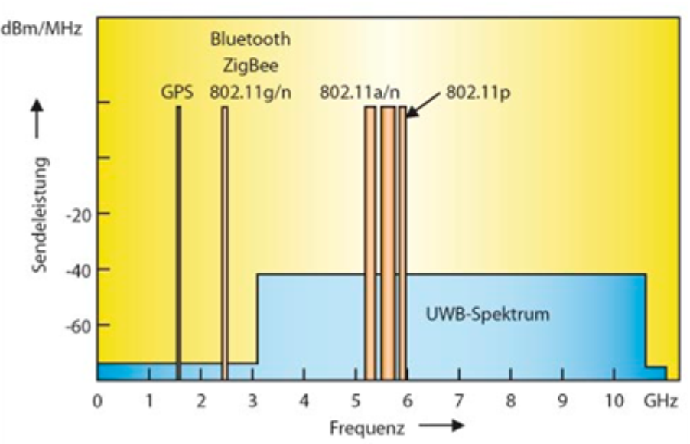
UWB
range 3.1 GHz to 10.6 GHz
limited transmit power of -41dBm/MHz
very low power density levels
for short-distance application

Slide 8
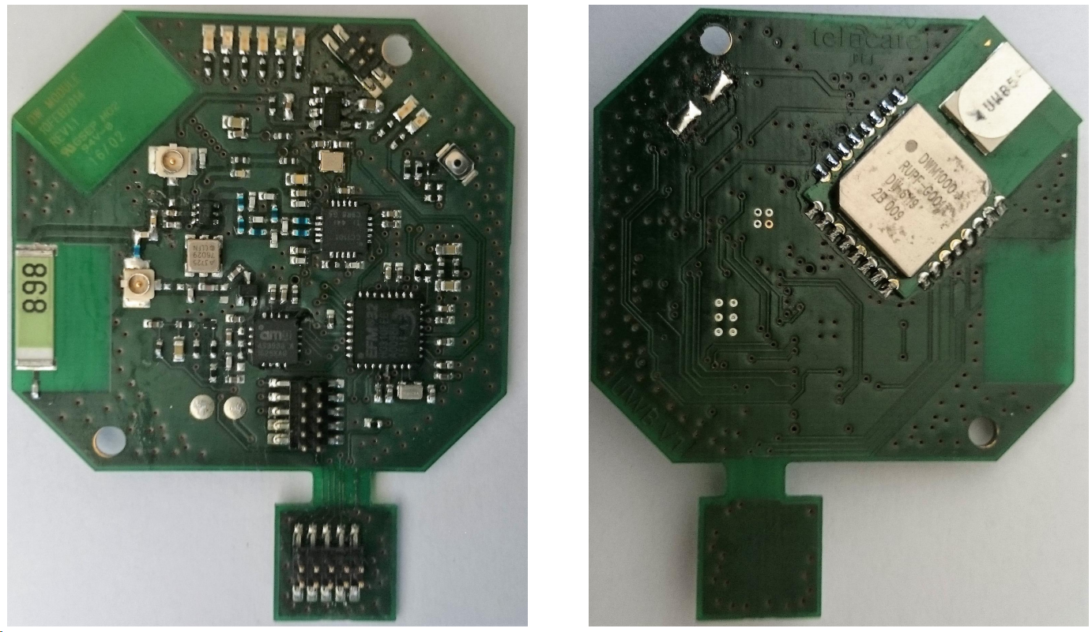
UWB
range 3.1 GHz to 10.6 GHz
limited transmit power of -41dBm/MHz
very low power density levels
for short-distance application
+ UWB communication
- Sampling rate low, 0.2Hz
- Data obtained rate low, 0.46%
UWB devices: anchor node and mobile tag, Telocate

Slide 9
UWB
UWB devices: anchor node and mobile tag, Telocate
+ UWB communication
- Sampling rate low, 0.2Hz
- Data obtained rate low, 0.46%
UWB devices: anchor node and mobile tag, Telocate

Slide 10
Scope of Work
UWB System Improvement
System Performance Evaluation
Estimation of positions of tag using EKF
Estimation of positions of tag and nodes simultaneously
loop end condition
sampling rate
Energy mode changed
date obtained rate
mutex(mutual exclusion)

Slide 11
Scope of Work
UWB System Improvement
System Performance Evaluation
Estimation of positions of tag using EKF
Estimation of positions of tag and nodes simultaneously
loop end condition
sampling rate
Energy mode changed
date obtained rate
mutex(mutual exclusion)

Slide 12
UWB System Improvement
Loop end condition
Energy mode changed
RTC
&&
Detection of task accomplishment
RTC only
Energy Mode 3
Energy Mode 2
 | Energy Mode 3 | Energy Mode 2
low-frequency oscillator | off | on
RTC | off | on
WDOG | off | on
consumption | 0.5 µA | 0.9 µA

Slide 13
UWB System Improvement
Mutex(mutual exclusion) added
set_RTC
set_RTC
set_RTC
recieved_msg1&& ckeck
send_msg_1
send_msg_1
recieved_msg3&& ckeck
set_RTC
recieved_msg3&& ckeck
send_msg_3
send_msg_2
recieved_msg2&& ckeck
send_msg_2
end
end
NODE_1
end
TAG
NODE_2

Slide 14
UWB System Improvement
Mutex(mutual exclusion) added
set_RTC
set_RTC
send_msg_1
send_msg_1
recieved_msg3&& ckeck
recieved_msg3&& ckeck
send_msg_2
send_msg_2
end
end
NODE_1
NODE_2

Slide 15
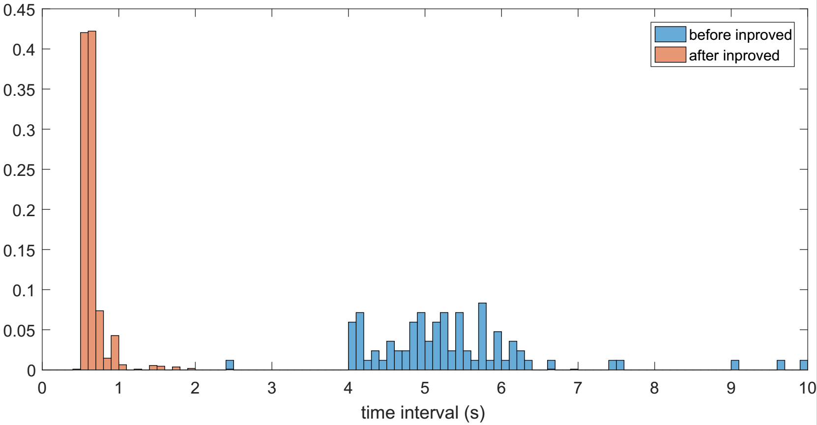
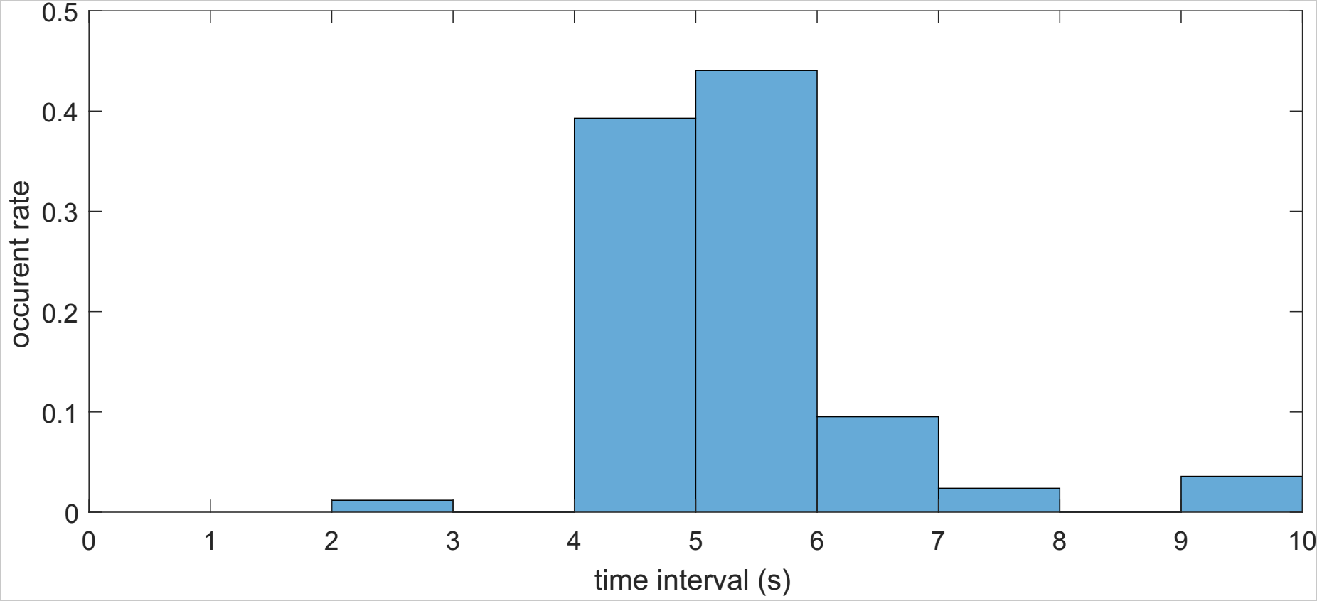

Sampling Rate
in details (numbers)
 | time interval (mean) | sampling rate (mean)
before improved | 5.2s | 0.2Hz
after improved | 0.7s | 1.5Hz

Slide 16
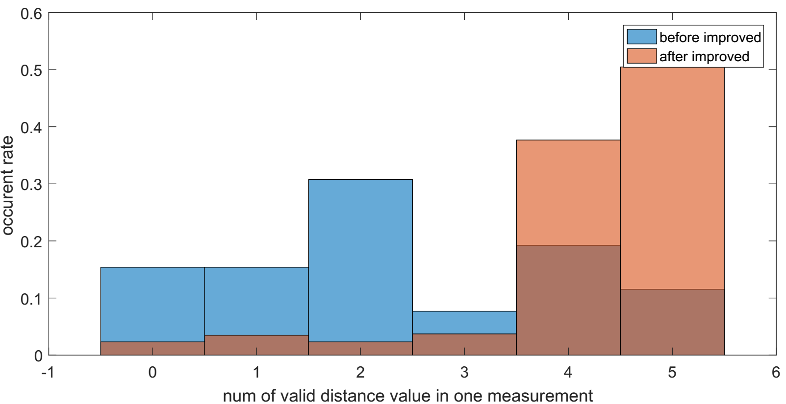
Date Obtained Rate
in details (numbers)
 | data obtained rate
before improved | 0.463
after improved | 0.842

Slide 17
System Performance Evaluation
Positions of tag estimation with different combinations of measurements using EKF
For each sampling, 30 ms time gap bezween measurement data from nodes
Estimation of positions of tag and nodes simultaneously (Calibration-free Localization)
  no preknowledge of nodes' positions are needed
EKF updates
per 5 measurements
per measurement
time

Slide 18
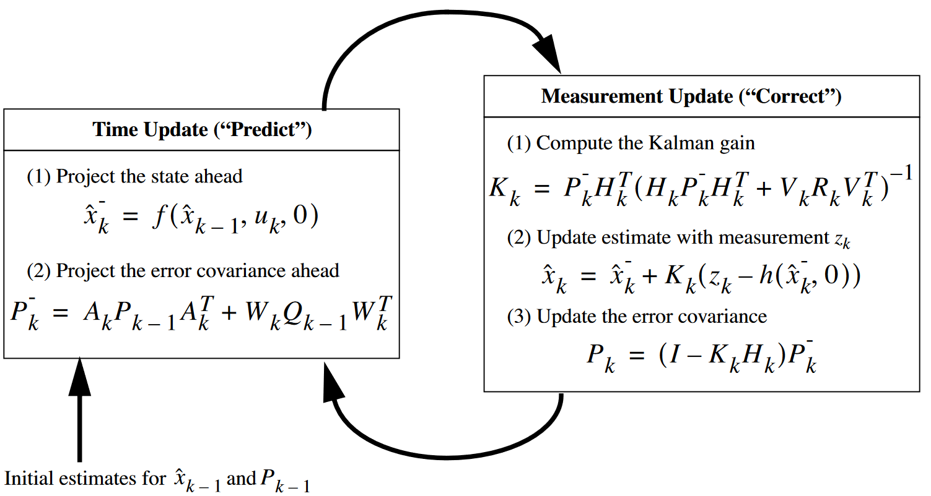
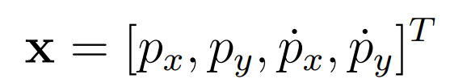
EKF
state vactor
state transition model
observation model

Slide 19
Calibration-free Localization
2D environment
Assume: N nodes, M samples from tag's trajectory
Unkown: 2*(M+N)
Known: M*N measurements
solvable: 2*(M+N) <= M*N

Slide 20
Outline
Motivation
Scope of Work
Result
Conclusion

Slide 21
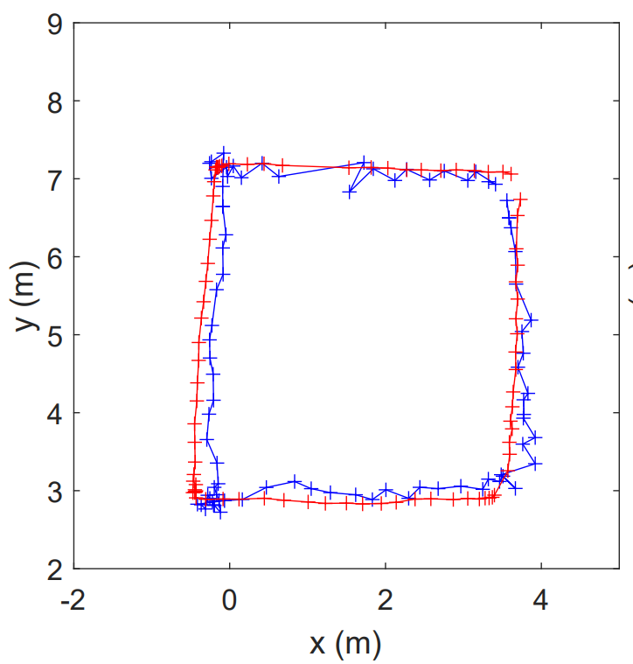
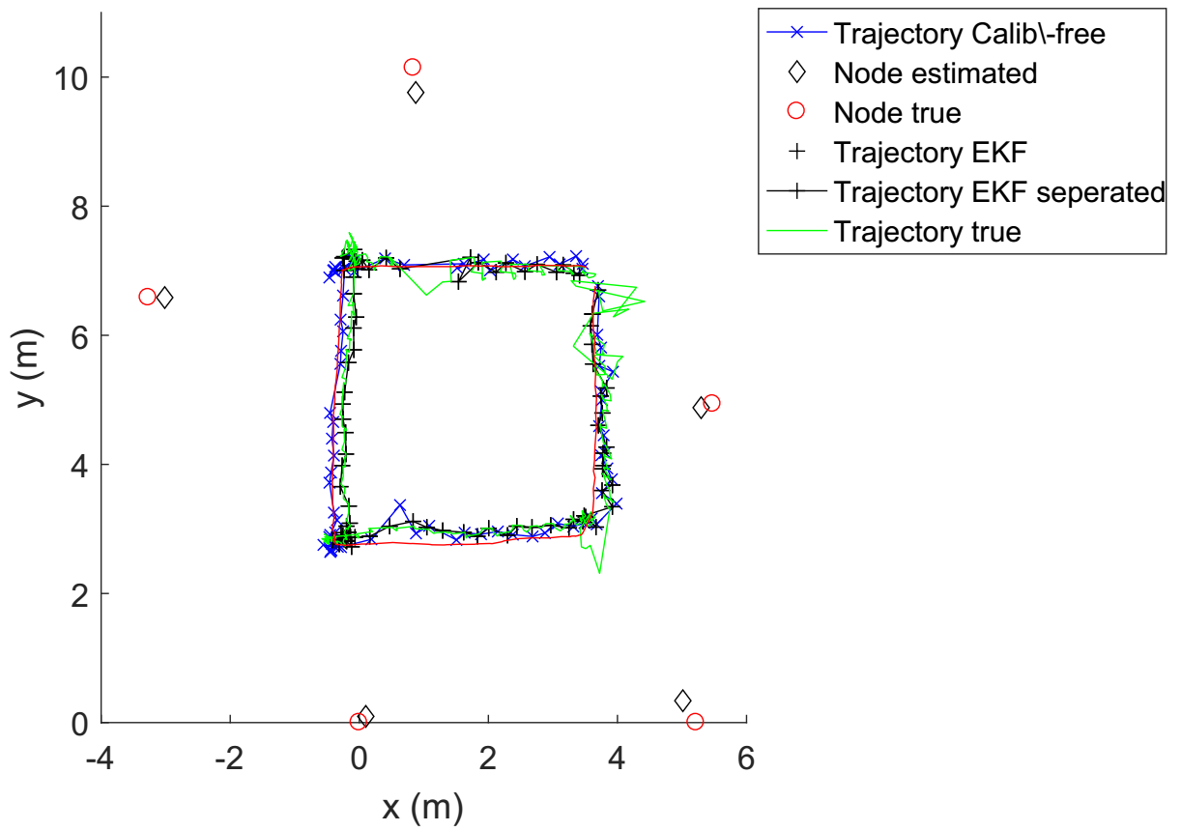
System Performance Evaluation
a
 | RMSE | Min(error) | Max(error)
EKF | 0.2188 | 0.0073 | 0.4131
EFK Separated Form | 0.2454 | 0.0090 | 0.9167
Calibration-free Localization | 0.2126 | 0.0041 | 0.6312

Slide 22
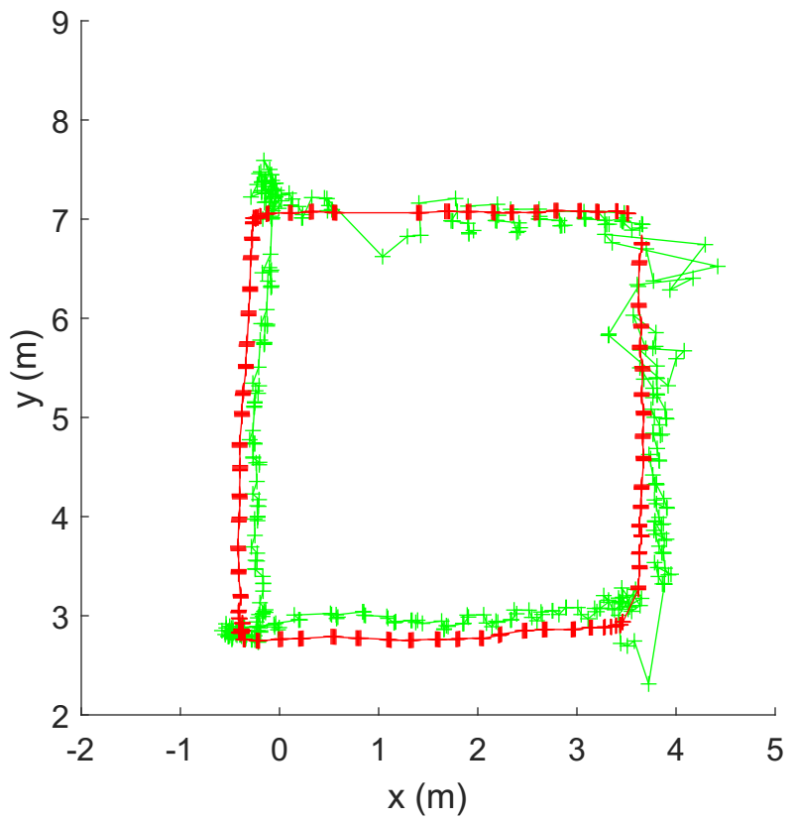
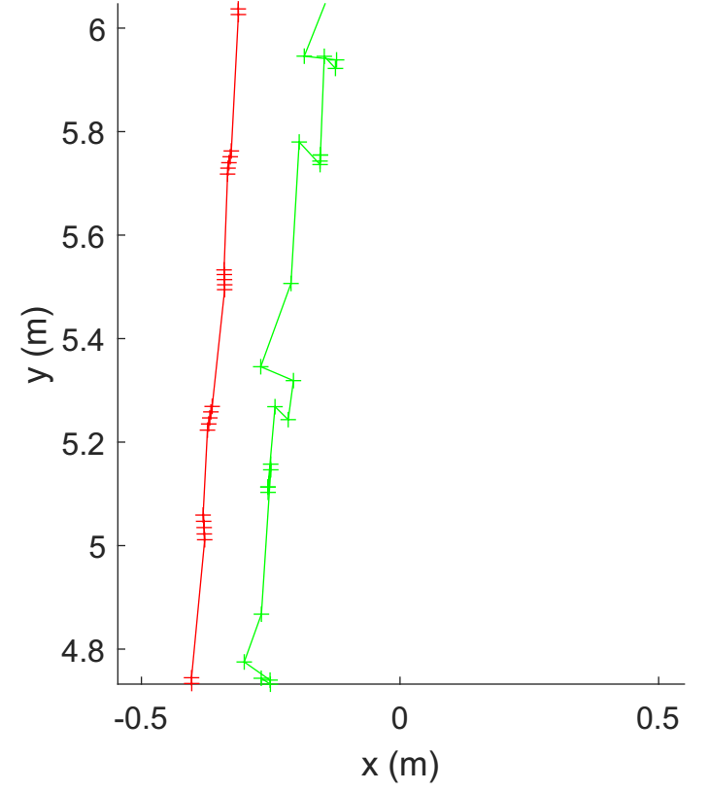
Result - EKF seperation form
a
a

Slide 23
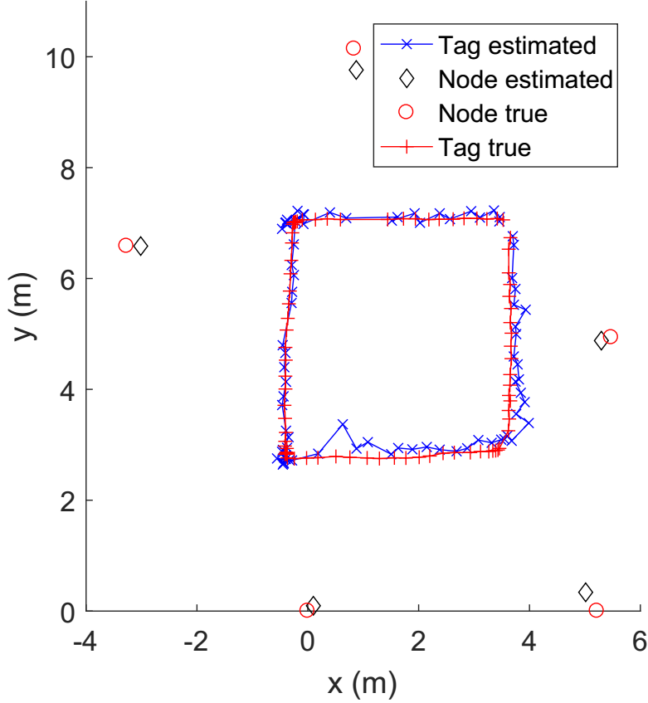
Result - self-calibration

Slide 24
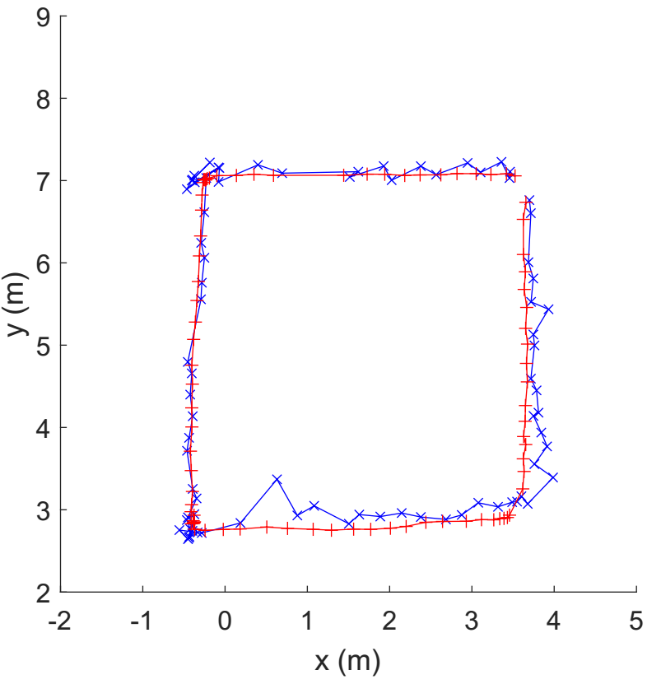
Result - comparision
EKF self-calibration

Slide 25
Outline
Motivation
Scope of Work
Result
Conclusion

Slide 26
Conclusion
Hardware: sampling rate increased
data obtained rate increased
Algorithm: 3 algorithms built
recover trajectory succeed

Slide 27
The End
Thank you for your attention!

Slide 28
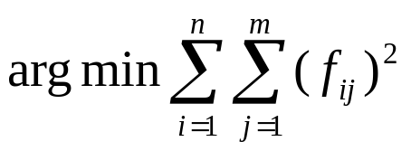
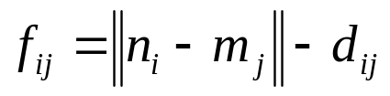
Scope of Work - Algorithm Development
- self-calibration
optimization method (Levenberg-Marquardt algorithm)

Slide 29
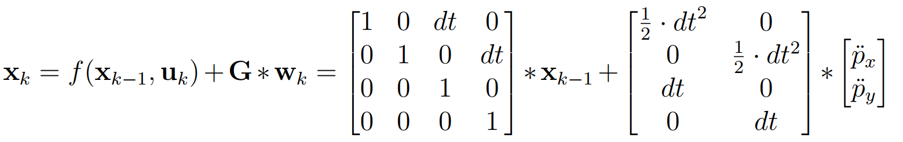

Scope of Work - Algorithm Development
update using one measurements set (contains 5 measurements)
normal EKF
EKF seperation form
+4
+3
+1
+2

Slide 30
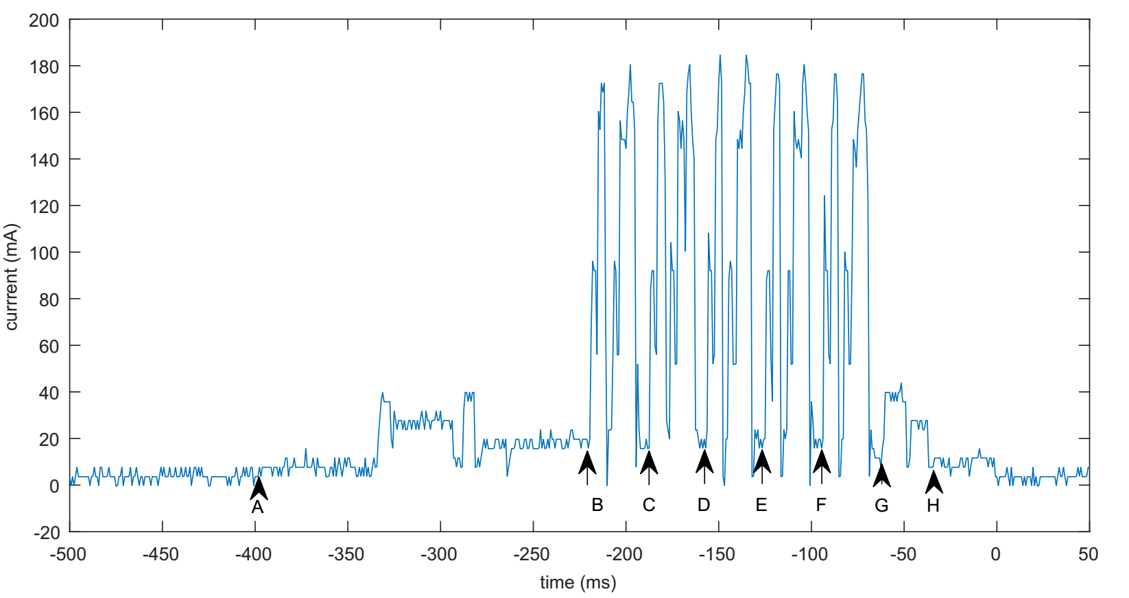
Scope of Work - Algorithm Development
sampling cycle of mobile tag (with 5 anchor nodes)
+1
+2

Slide 31





Calibration-free Localization
2D environment
Assume, n anchor nodes
m samples from tag's trajectory
in total variables
known: measurements
equation system can be solved when
2D environment
Assume, N nodes, M samples from tag's trajectory
Unkown: 2*(M+N)
Known: M*N measurements
solvable: 2*(M+N) <= M*N

Slide 32
Scope of Work - Algorithm Development
state transition model

Slide 33

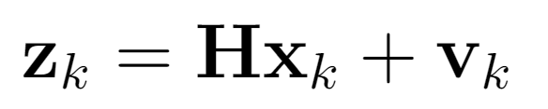
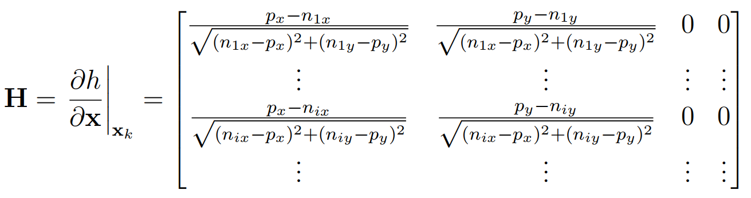
Scope of Work - Algorithm Development
observation model

